Slide 1
The Kitchen Pharmacy Recipes
October 17, 2020
Yufang Lin, M.D. FAAP, FACP, ABOIM, IFMCP
Integrative Medicine Specialist
Center for Integrative & Lifestyle Medicine

Slide 2
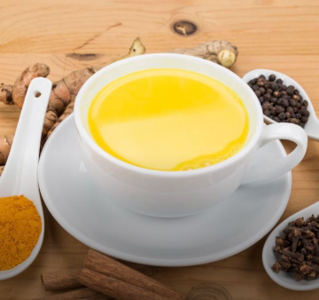
Golden Milk Tea
You will need:
Two cups milk (coconut, almond, soy, etc)
Ginger: ½ tbsp. fresh or 1/2 tsp powder
Turmeric: 1 tbsp. fresh or 1 tsp powder
3-4 peppercorns (or a pinch of black pepper)
What to do:
Combine all in a small pot. Simmer stovetop for 10 minutes.
Strain, drink 1 cup once to twice a day
https://www.drweil.com/diet-nutrition/anti-inflammatory-diet-pyramid/anti-inflammatory-golden-milk/

Slide 3
The Cold Buster
You will need:
1 inch knob of fresh ginger, thinly sliced or chopped (or ½ teaspoon dried ginger)
½ teaspoon of goji berries or ¼ teaspoon or rosehips
2 -3 slices of dried astragalus root
What to do:
Combine all above and add 2 cups of water, bring to boil and simmer for 10 minutes. Strain, add raw honey to taste. Drink 1 cup 2-3 times a day as needed for pain control
The Pain Buster
This is a recipe I make at the first sign of cold of flu. Harnessing the antiviral, antibacterial property of ginger and raw honey, vitamin C of goji berries or rose hips, immune support from astragalus, and the soothing property of steaming cup of tea, this decoction has rescued me many times from developing a full blown cold during winter months as a busy physician.
Notes:
Ginger is great for inflammation and pain

Slide 4
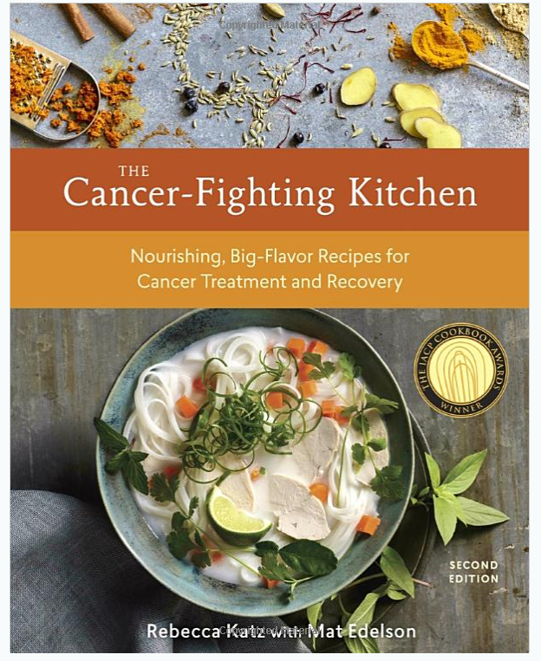
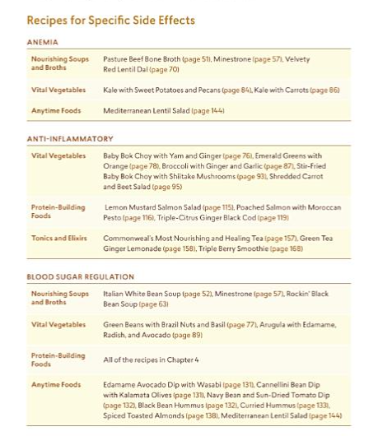

Slide 5
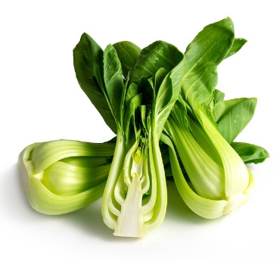
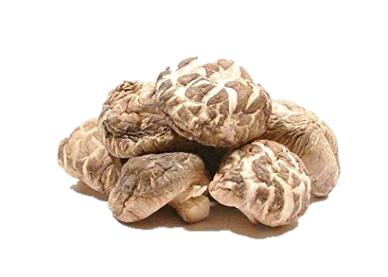
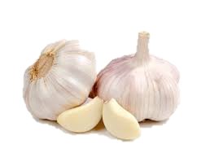
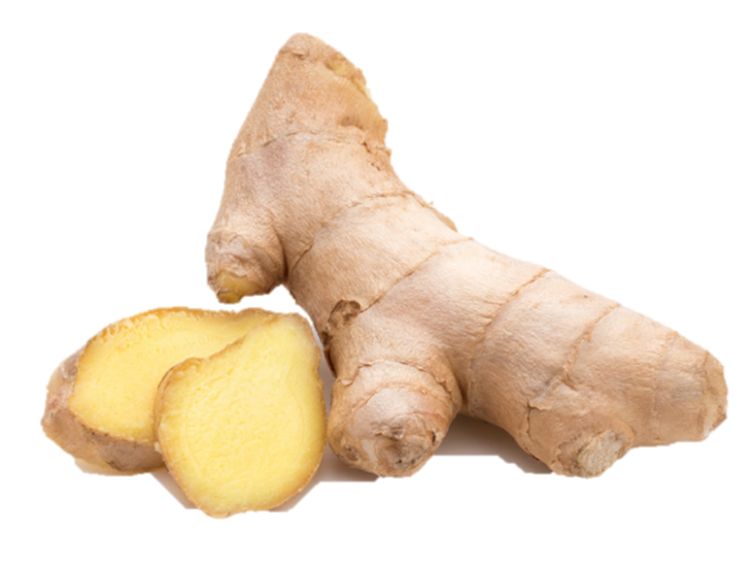
Stir-Fried Baby Bok Choy with Shiitake Mushrooms (Rebecca Katz)
Trim the base off the bok choy and discard. Trim the leaves from the stems and cut both crosswise into bite size pieces, keeping the stems and leaves separate
Heat the light sesame oil in a saute pan over medium heat, then add the scallions, ginger, garlic, mushrooms, and a pinch of salt and saute for 30 seconds. Add the water, tamari, and the bok choy stems and sauté for 2 minutes. Add the bok choy leaves, line juice, toasted sesame oil, and a pinch of salt and sauté until the bok choy is just wilted, about 2 minutes. Taste and add another squeeze of line if you like. Sprinkle with toasted sesame seeds and serve immediately.
Serve: 6
Prep time: 15 min
Cook time: 5 min
4 heads baby bok choy
2 tablespoons light sesame oil
2 scallions, white parts only, thinly sliced
2 tbsp fresh ginger, minced
2 cloves garlic, minced
½ lb shiitake mushrooms, stemmed and sliced ¼ inch thick
Sea salt
2 tbsp. water
1 tbsp. tamari
1 tbsp. freshly squeezed lime juice
1 ½ tsp toasted sesame oil
1 tbsp. toasted sesame seeds
Katz, R. & Edelson, M. (2017) The Cancer-Fighting Kitchen: Nourishing, Big-Flavor Recipes for Cancer Treatment and Recovery. 2 Ed. Berkeley, CA. Ten Speed Press. P 93

Slide 6
Chocolate Apricot Date Nut Truffles (Rebecca Katz)
Soak the dried apricot in water for 5 minutes.
Stir the boiling water into the chopped chocolate and let stand for 30 seconds. Whisk until melted and glossy.
Combine coarsely ground almond, orange zest, salt and chocolate in food processor until smooth (~1 min). Add well drained apricot. Cover and chill for 2 hours until firm.
Scoop 1 tbsp. of mixture and roll it into a smooth ball, then roll in coconut to coat.
Makes 20 truffles
Prep time: 15 minutes
Cook time: 2 hours in fridge
¼ cup finely diced dried apricots
2 tbsp. boiling water
2 oz dark chocolate (64-72% cocoa content, finely chopped)
1/3 cup + 2 tbsp. almonds, coarsely grounded.
1 cup pitted and halved medjool dates
1 ½ tsp orange zest
1/8 tsp se salt
½ cup unsweetened shredded coconut

Slide 7
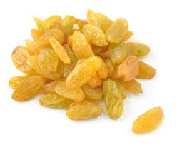
Raisin Reduction (Chef Jim Perko)
Place raisins and water in covered saucepan and simmer on low heat until approximately 3 tablespoons of water remain. (About 13-15 minutes). Let cool. Blend in blender. Stop, scrape sides of blender. Keep blending until raisins have been fully pureed’ and smooth.
Chef Jim Notes: This raisin reduction recipe is a great way to sweeten recipes without adding processed sugars. Raisins also contain dietary fiber, protein and antioxidants
Makes 12 serving
2 cups golden raisins
2 cups water
Jim Perko, Culinary Medicine Tool kit. https://www.ccemployeewellness.com/culinary-medicine-toolkit
Notes:
Golden raisin https://za1320627555hybv.trustpass.alibaba.com/product/62012228383-231838030/Golden_Raisin.html

Slide 8
Berry Oatmeal Crisps (Chef Jim Perko)
In a large mixing bowl, combine and mix well the berries, chia seed, zest, and two tablespoons of raisin reduction. Pour into a glass 9”x13” baking pan.
For the topping, first combine and whisk together the almond milk and one tablespoon raisin reduction. In a separate bowl, combine remaining six dry ingredients and whisk together to thoroughly mix.
Add the combined wet mixture to the dry and mix well to make crumb topping. Sprinkle on top of fruit mixture.
Bake in a pre-heated 400 degree oven for 25 minutes. Remove, let set for 15 minutes and serve
Makes 12 servings
1 tbsp. Chia seed
Zest of 1 orange
4 cups blueberries, rinsed
1 cup raspberries, rinsed
1 ½ cup strawberries, rinsed and quartered
2 tbsp. raisin reduction
3 oz unsweetened almond milk
2 cup quick oats
¼ cup gluten free flour
2 tbsp. flax seed, ground
1 tsp. baking powder
1 tsp. baking soda
¼ tsp salt

Slide 9
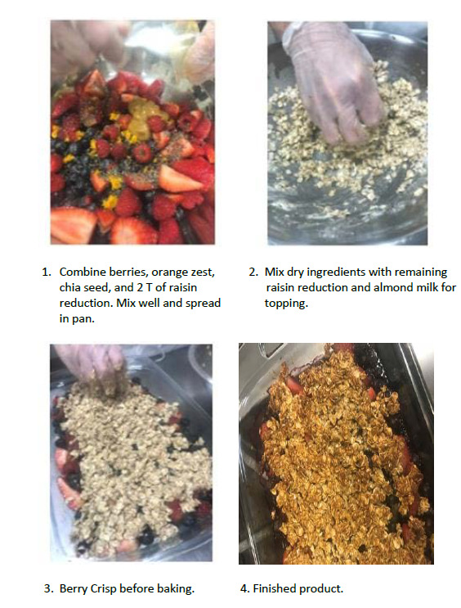
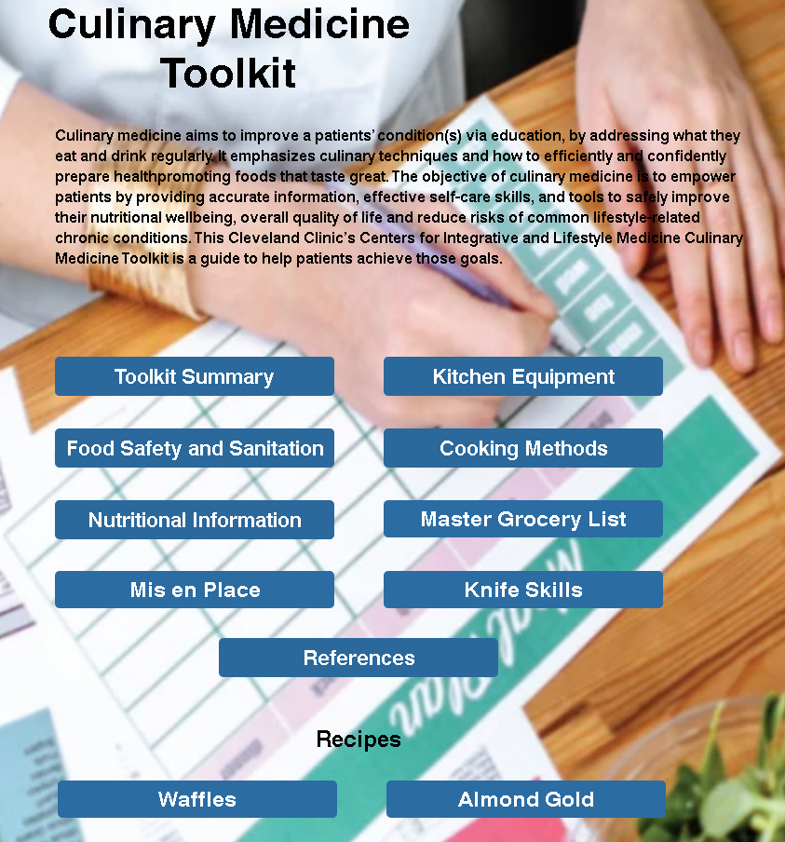
https://www.ccemployeewellness.com/culinary-medicine-toolkit

Slide 10
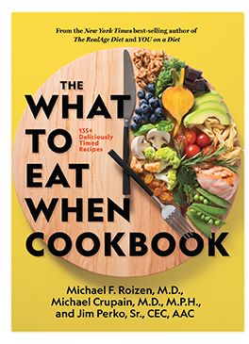
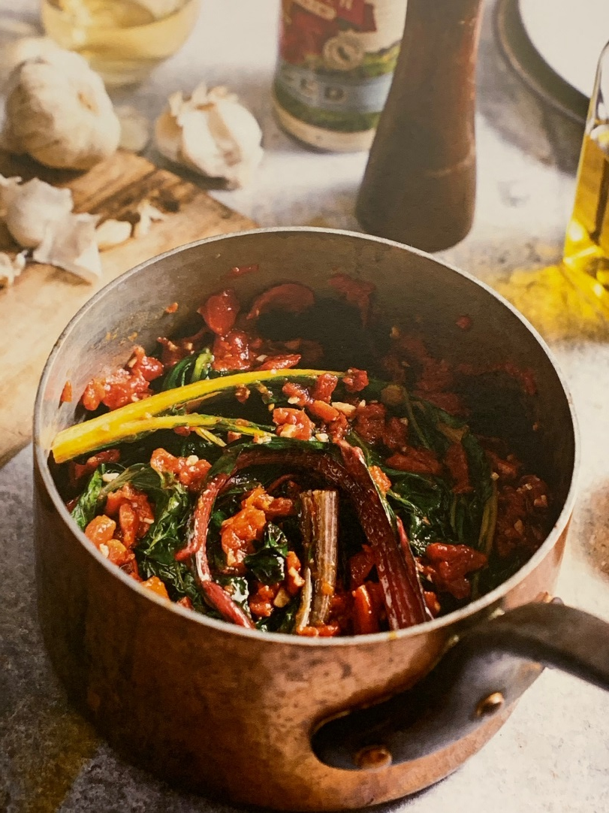
Tomato-Braised Swiss Chard (Chef Jim Perko)

Slide 11
Tomato-Braised Swiss Chard (Chef Jim Perko)
Bring water to boil. Add enough salt to make it salty like the sea.
Trim the tip off Swiss chard stems and discard. Wash and rinse well until no sand or dirt remains at the bottom of the bowl.
Add the chard to the pot of boiling water and cook about 3 minutes or until the water return to boil for a minute. Drain and shake off any excess water. Rinse and wipe dry the pot.
Return the chard to the pot, then add the tomatoes, wine, olive oil and garlic. Cook over medium heat until the sauce has thickened and both the chard stems and leaves are very soft, stirring occasionally, about 20 minutes. Season with salt and pepper and serve.
Makes 2 servings
4 quarts water
kosher salt
1 large bunch swiss chard
1 can (14.5 oz) diced or crushed tomatoes in juice
1/2 cup wine (red or white)
¼ cup extra virgin olive oil
3 large garlic clove (whole)
fresh pepper
From Roizen M, Crupain M, and Perko J. The What to Eat When Cookbook. Washington DC, National Geographic Partners., 2020.

Slide 12
Remember..
If you have a kitchen, you have a Kitchen Pharmacy

Slide 13
Thank You
Yufang Lin, MD, FAAP, FACP, ABIHM, ABIOM, IFMCP
Center for Integrative & Lifestyle Medicine
(216) 448-4325
Wellness Institute Lakewood Family Health Center
1950 Richmond Road 14601 Detroit Ave
Lyndhurst, OH 44124 Lakewood, OH 44107
(216) 448-4325 (216) 237-5500

